Slide 1
Office Dev Day Lisbon 2018
#OfficeDevDayLX #OfficeDev

Slide 2

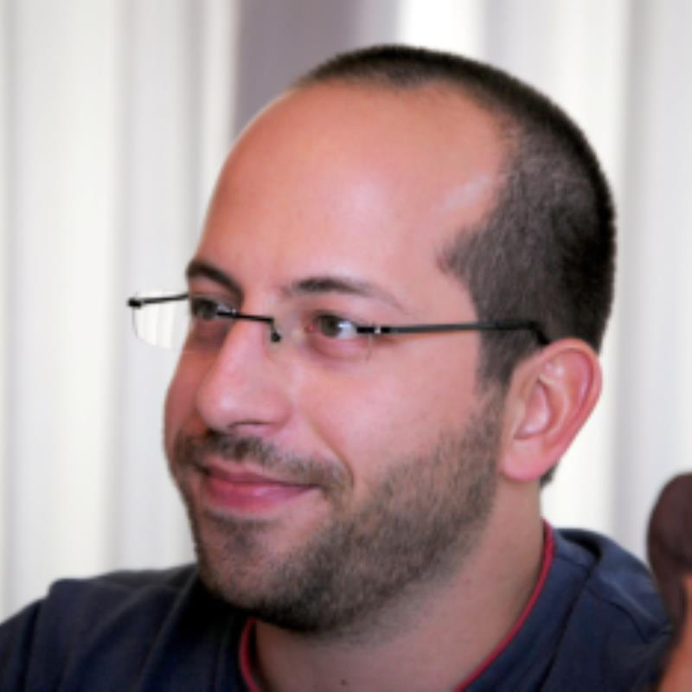
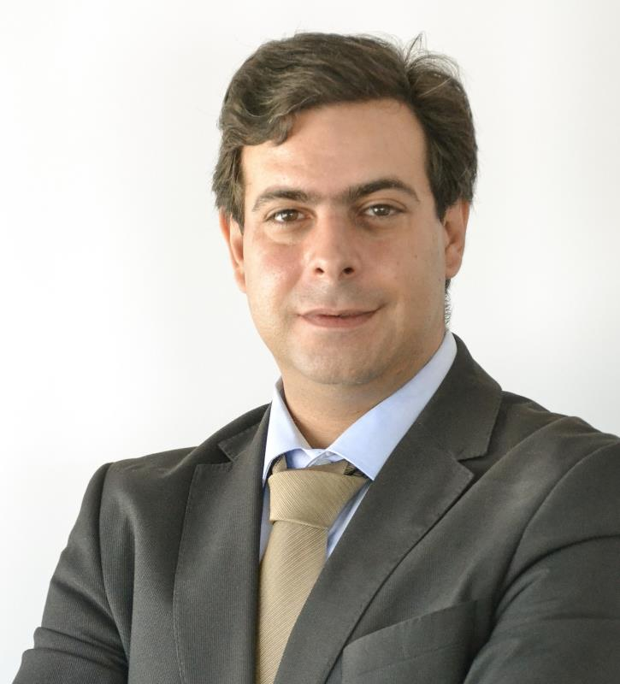
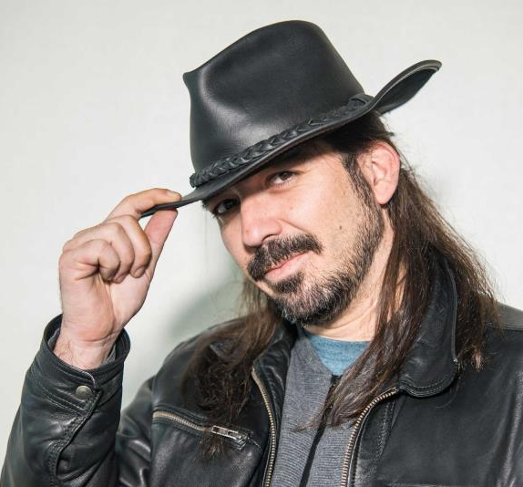
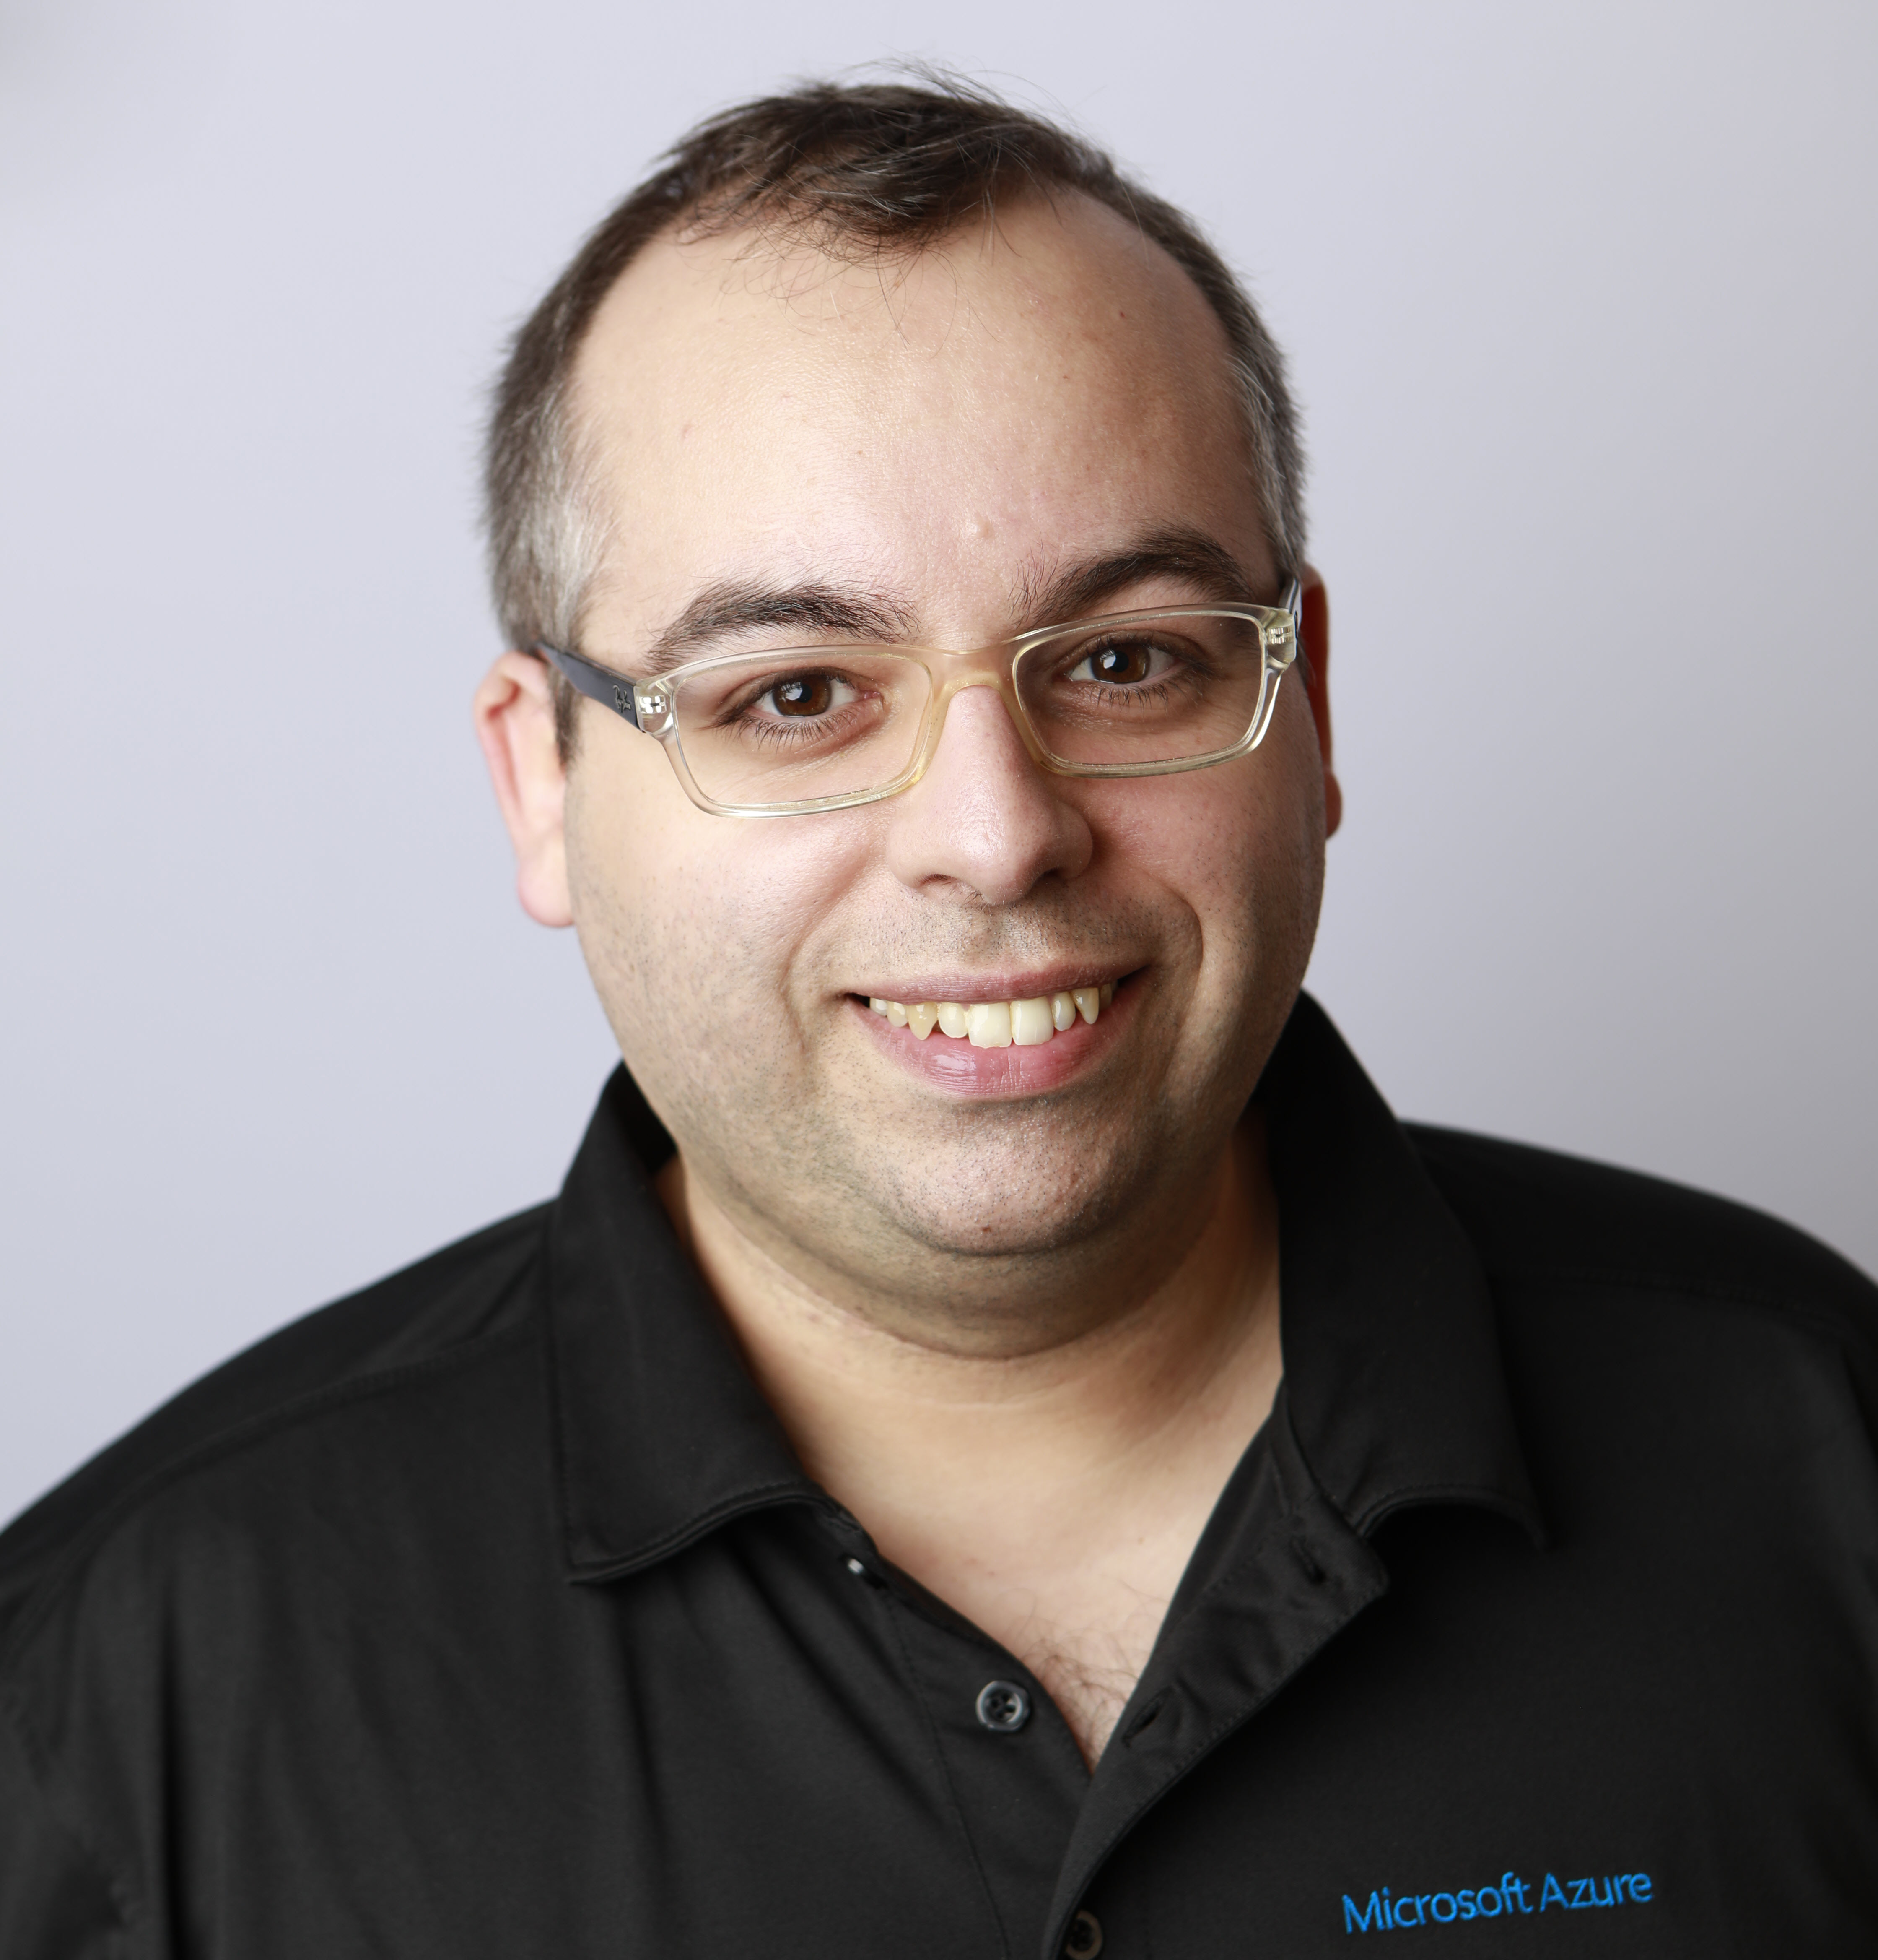
Organization
Office Servers and Services MVP’s
André Vala
@atomicvee
Nuno Árias
@nunoariassilva
Rodrigo Pinto
@ScoutmanPt
Tiago Costa
@tiagocostapt

Slide 3
Internet Event Code
msevent425qu

Slide 4
Agenda
09h00 - Registration
09h30 - Welcome and Introduction
10h00 - "Microsoft Teams - A vision for Intelligent Communications" by Nuno Arias Silva, MVP & MCT
11h00 - Coffee Break
11h15 - "Creating Intelligent Applications with Microsoft Graph" by Tiago Costa, MVP & MCT
12h15 - Lab Time
13h00 - Lunch Break & Lab Time
14h00 - "Extending Microsoft Teams" by André Vala, MVP
15h00 - Lab Time
15h45 - "SPFx: The modern SharePoint Framework" by Rodrigo Pinto, MVP
16h45 - Lab Time
17h30 - Closing

Slide 5
Slides and Demos
https://github.com
/OfficeDevDayLisbon/2018

Slide 6
Announcements

Slide 7

TUGA IT 2018 Summer Edition
19-21 July 2018
Microsoft Portugal HQ – Lisbon
http://tugait.pt/2018
Call for Speakers open until May 31st!

Slide 8

SPS Lisbon 2018
13 October 2018
Microsoft Portugal HQ – Lisbon
3 Tracks about SharePoint, Office 365 and Azure
http://www.spsevents.org/city/lisbon/lisbon2018
Register ASAP with special code: OfficeDevDayRocks!!!
This ticket will give you a VIP entrance to SPS Lisbon.

Slide 9
Resources

Slide 10
Developer Program
1 YEAR FREE
E-mail Newsletters
Free Developer Subscription
Free Training
Free Tools
Webinars
http://dev.office.com/devprogram

Slide 11
Let’s have fun!!!!

